Slide 1
ArchiMate®
Layering
Notes:
0:00

Slide 2



MOTIVATION
BUSINESS
Language
Notation
Deliverables
APPLICATION
Who are you?
What’s wrong?
How do we fix it?
Notes:
This is the good bit!

Slide 3
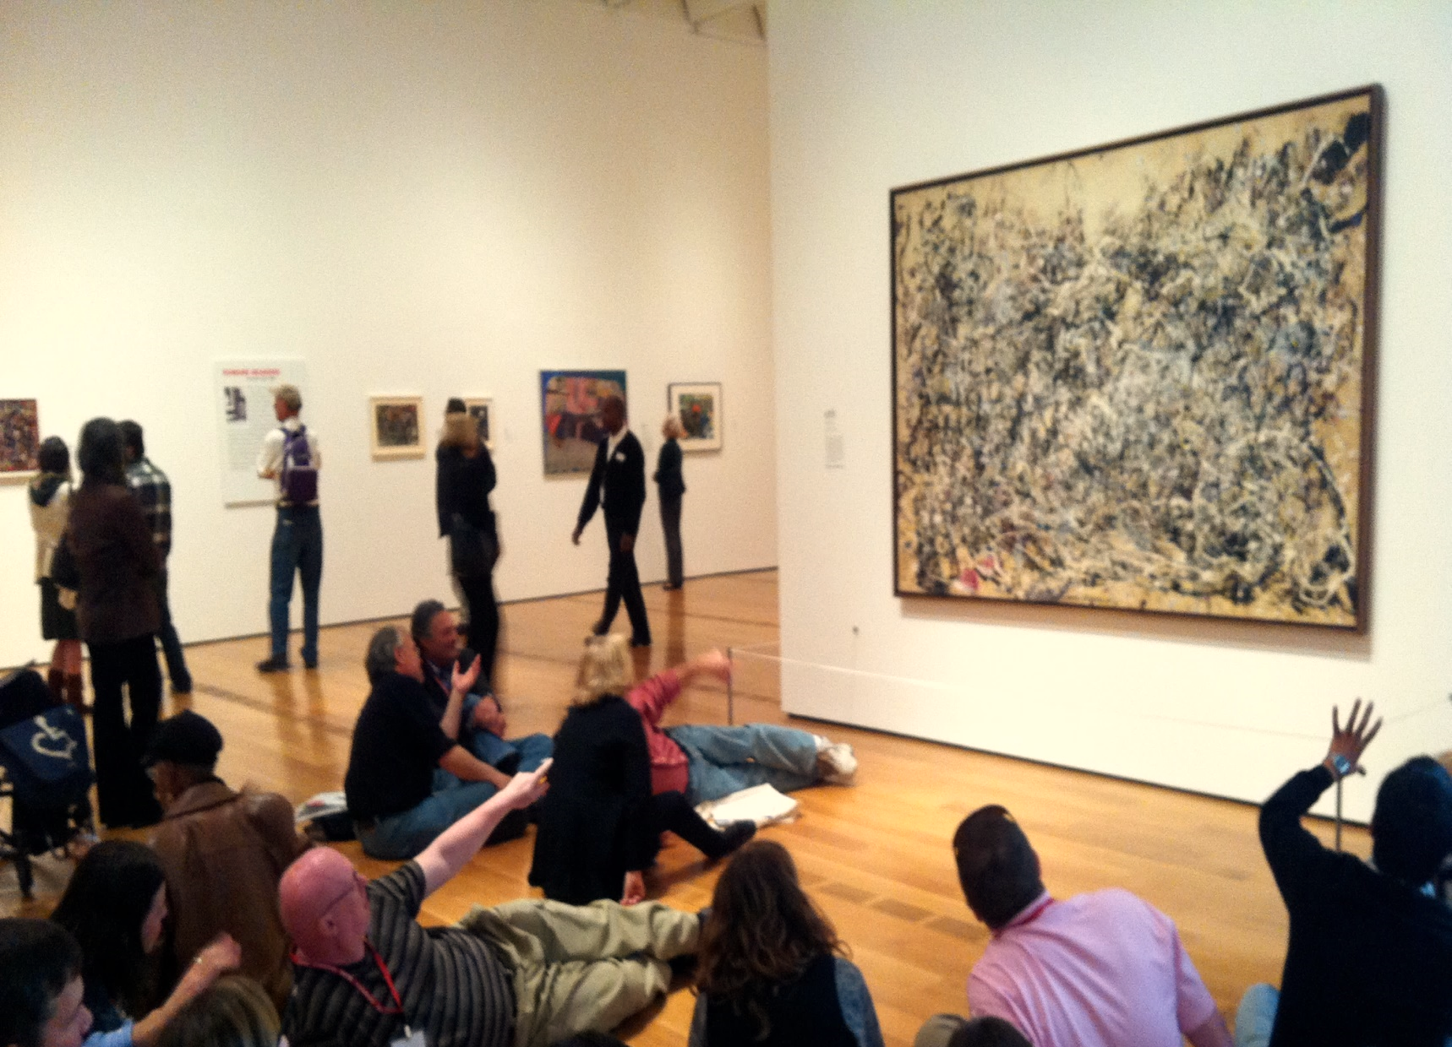
How do technologies support our business?
What is it that makes one application more valuable than another?
What are the critical components of our business?
What security applies to my application?
FORM
AUDIENCE
MESSAGE

Slide 4
Application Viewpoints
Application Behaviour
Application Co-operation
Application Structure
Business Viewpoints
Layered Viewpoints
Organization
Actor Co-operation
Business Function
Business Process
Business Process Co-operation
Product Viewpoint
Application Usage
Information Structure
Infrastructure Usage
Implementation & Deployment
Layered
Requirements Realization
Notes:
Now?
Audience?

Slide 5
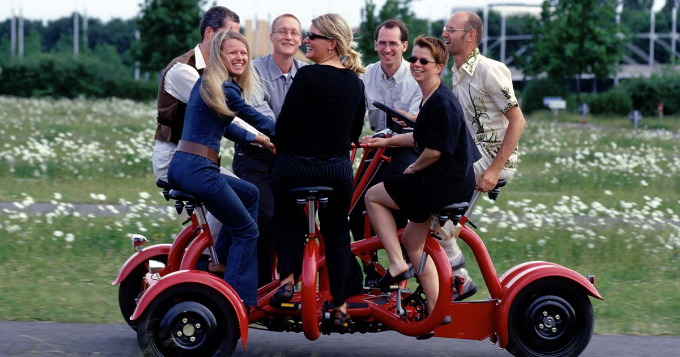
BUSINESS ANALYST
DEVELOPER
SERVER ADMIN
HELPDESK ANALYST
PRODUCT OWNER
NETWORK ENGINEER
SPONSOR
PROJECT MANAGER
Notes:
HARD WORK COMES TOGETHER
WE CAN TELL THE STORY

Slide 6
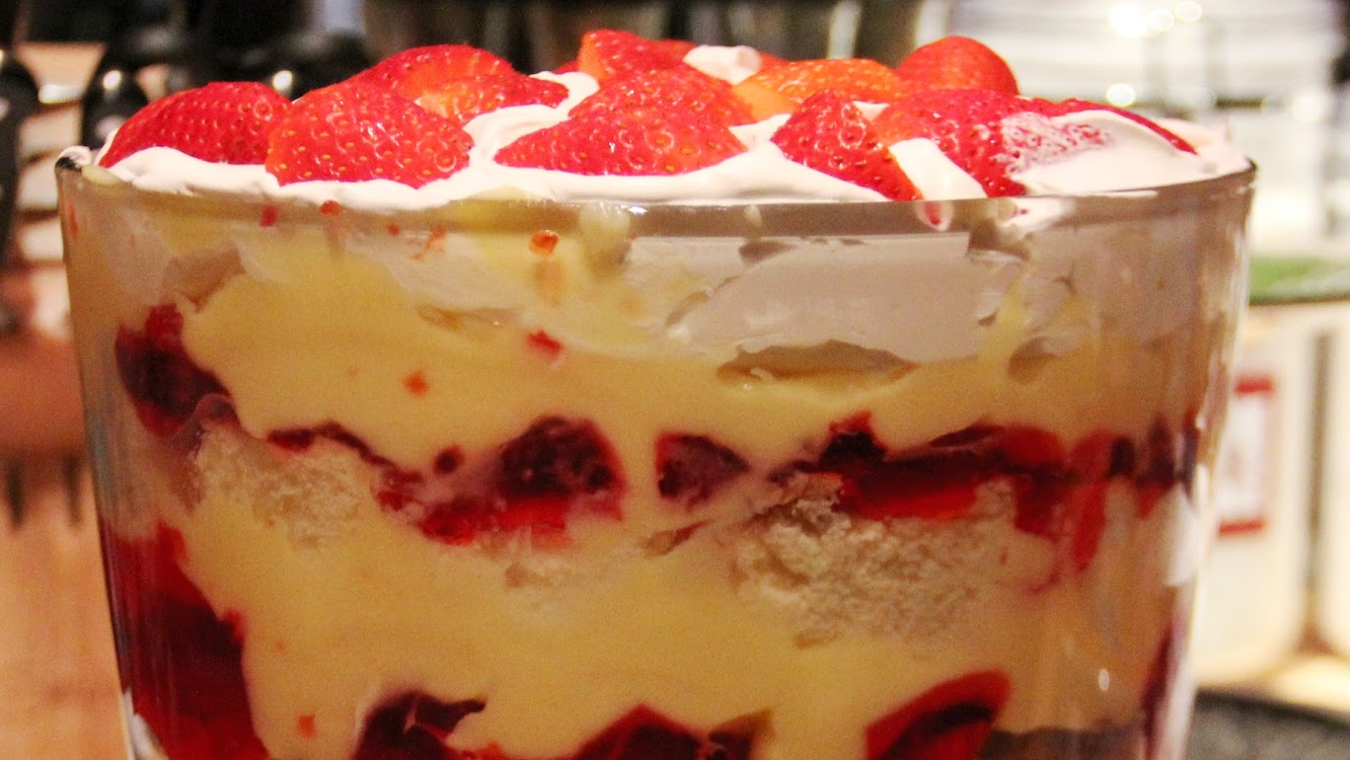
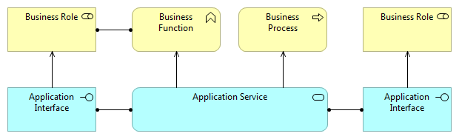
The most important relationship between layers is formed by
USED BY
Notes:
(And of course, collaborations / interactions as well)
BEHAVIOURAL ELEMENTS USE ONE ANOTHER
ACTIVE ELEMENTS USE ONE ANOTHER
So – here we’ve got an application interface being USED BY a business role. They do that because they are both ACTIVE elements.
QUESTION: what are the others possible, then?
And we have SERVICES being USED BY either BUSINESS FUNCTION or BUSINESS PROCESS
Why is this awesome?
HEY TAZ! Component X is used by Y business unit
HEY CRAIG! If you upgrade A you affect X, Y, and Z

Slide 7
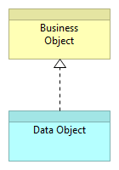
Elements in lower layers may
REALIZE
comparable elements in higher layers
Notes:
So we’ve talked about ACTIVE and BEHAVIOURAL elements being connected through USED BY
What about OBJECTS? Well, they REALISE one another.
So some data object – like a table in a database – becomes something in the BUSINESS layer.
HEY PAT! If X is RESTRICTED DATA, then Y is a processing RESTRICTED DATA.

Slide 8
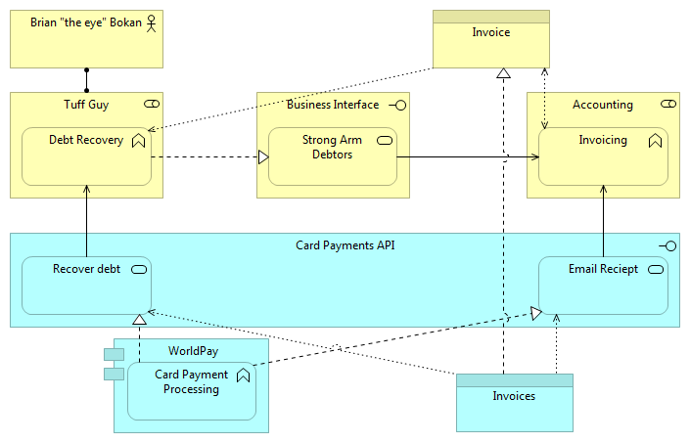
Notes:
VOLUNTEER : Explain

Slide 9
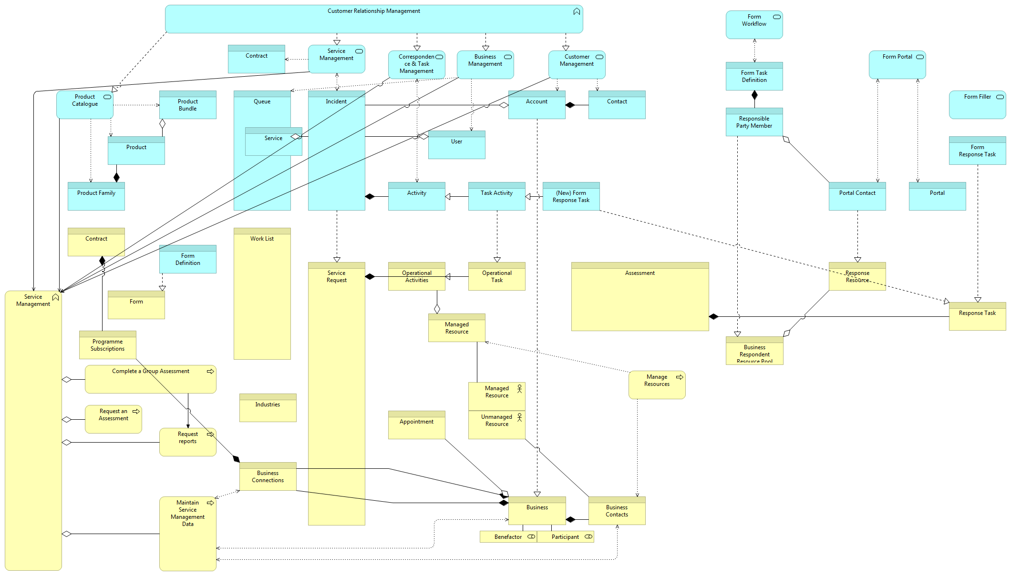
Notes:
CRAZY TOWN
SYNERGY between business and the application
COMPLEXITY – this is a BAD DIAGRAM! – strategies?
FORM
AUDIENCE
MESSAGE

Slide 10

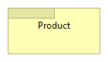
Notes:
And then there’s one that matters: PRODUCT
Remember this one – we’ll come back to it!

Slide 11

A product represents a coherent
COLLECTION OF SERVICES
accompanied by a
CONTRACT
or set of agreements
OFFERED AS A WHOLE
to internal / external customers

Slide 12
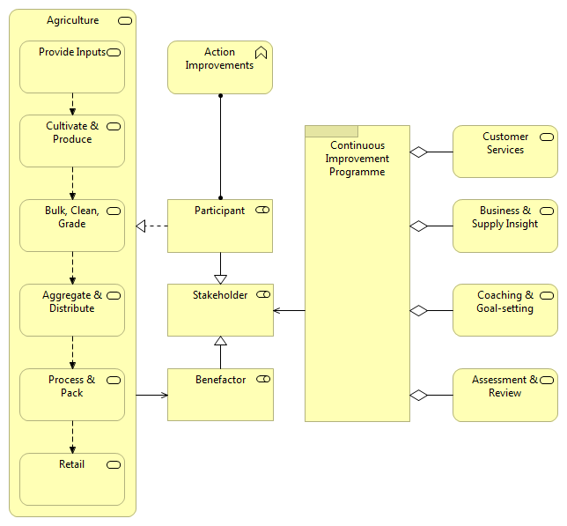
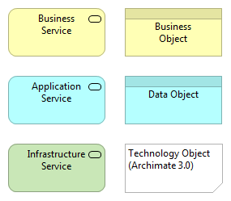
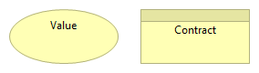

Slide 13
Create an application usage diagram Keep it simple! Collate COMPONENTS and INTERFACES Collate ROLES, PROCESSES and / or FUNCTIONS Draw the NOW Draw the FUTURE

